Slide 1
Pre-Orientation
ELTE Facutly of Humanities, Department of International Affairs
Ms. Lilla Gilián: Erasmus+ student coordinator
Mr. Sándor Balaci: Guest student coordinator

Slide 2
Contents
Webpages, social media
Orientation
Legal stay
Student ID
Bank account
Campus
Academic regulations
Technical and practical issues
Documents during the semester
Courses
Neptun, Course registration
Contents

Slide 3
Webpages, social media
Join our Facebook group:
Students of the Faculty
OFFICAL FACULTY WEBSITE
ELTE OFFICIAL WEBSITE
Follow us online
Follow us online

Slide 4
Orientation Week
Programme & useful information:
https://btk.elte.hu/welcome-to-our-new-students
https://www.btk.elte.hu/orientation-week
Orientation Week

Slide 5
Orientation Week & Semester starting
Erasmus+ and other exchange students
Monday, 13th February 2023 – Orientation Week starts - ONLINE
20th-26th February – Spring holiday
Monday 27th February 2023 – Classes start
Department of International Affairs (DIA) – Building A, office 44.
Programmes: https://www.btk.elte.hu/orientation-week
www.btk.elte.hu https://www.btk.elte.hu/welcome-to-our-new-students
Useful information for the start of the semester

Slide 6
Chapter 1 Stay here legally
Ch 1 legal stay

Slide 7
Border crossing, entry information
All COVID restrictions concerning border crossing are lifted. For further info, please check the following websites:
• https://www.police.hu/en
• https://www.elte.hu/en/visa-procedure/entry
Foreign students travelling to Hungary with a valid Hungarian residence permit for a period exceeding 90 days are treated in the same way as Hungarian citizens, thus they can enter Hungary without submitting a special request prior to their arrival.
In case of further questions please contact the consular services and Hungarian missions in your country: https://konzuliszolgalat.kormany.hu/hu-missions-abroad
Ch 1 legal stay

Slide 8
Keeping your stay legal
Students from the European Economic Area (EEA: member states of the EU and Norway, Switzerland, Iceland, and Lichtenstein) registration card.
Students from the non-European Economic Area (EEA): residence permit, and after your arrival in Hungary you need to register your accommodation.
Ch 1 legal stay

Slide 9
Keeping your stay legal EEA students
Obtain a Registration Card please visit the website from below and proceed according to the information you can find there:
Enter Hungary: https://enterhungary.gov.hu/eh/
Within 90 days after your arrival latest
More information:
https://www.btk.elte.hu/en/content/practical-matters.t.3375?m=227
Ch 1 legal stay

Slide 10
Keeping your stay legal Non-EEA students
Students in possesion of a D type of visa:
After your registration with the DIA please contact the National Directorate-General for Aliens Policing in order to obtain your residence permit. Please ask your administrative coordinator to issue the certificate of student status, that can be forwarded to you by e-mail too. This document is absolutely neccessary, together with the rest of the required documents.
Please check the website of the authority:
https://www.elte.hu/en/visa-procedure
NON-EEA (EU) student who entered Hungary without any visa:
We would suggest you to visit the website from below and make arrangements according to the information provided by the website:
Enter Hungary: https://enterhungary.gov.hu/eh/
Ch 1 legal stay

Slide 11
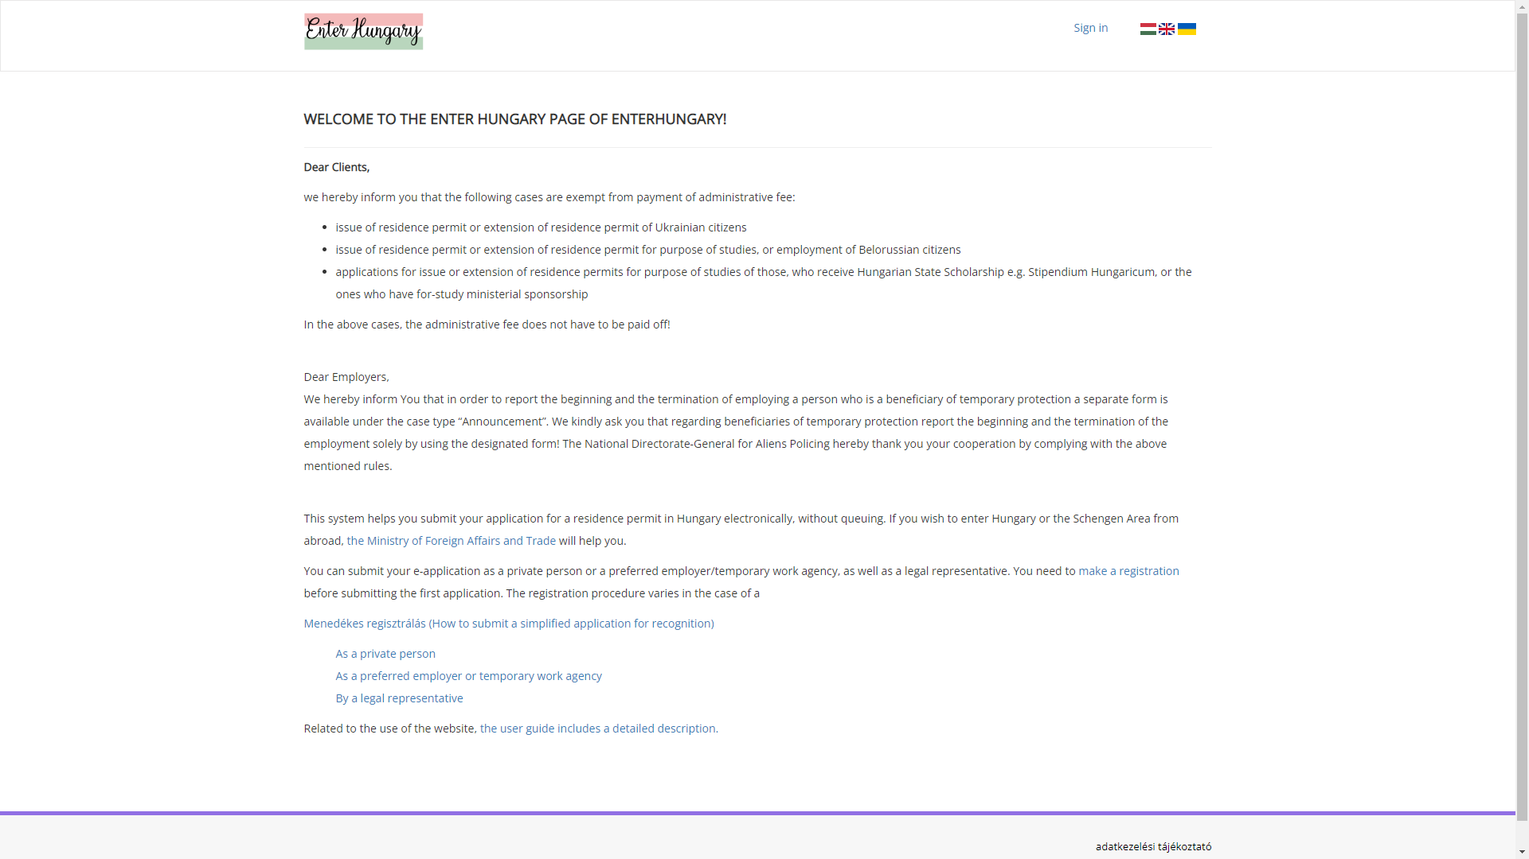

Slide 12
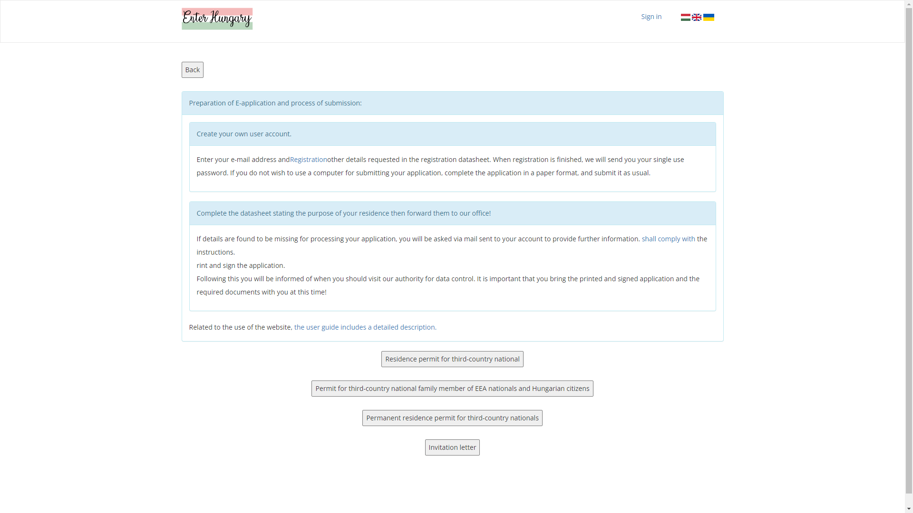

Slide 13
Keeping your stay legal
Questions: email to our visa coordinator: visa@elte.hu
Ch 1 legal stay

Slide 14
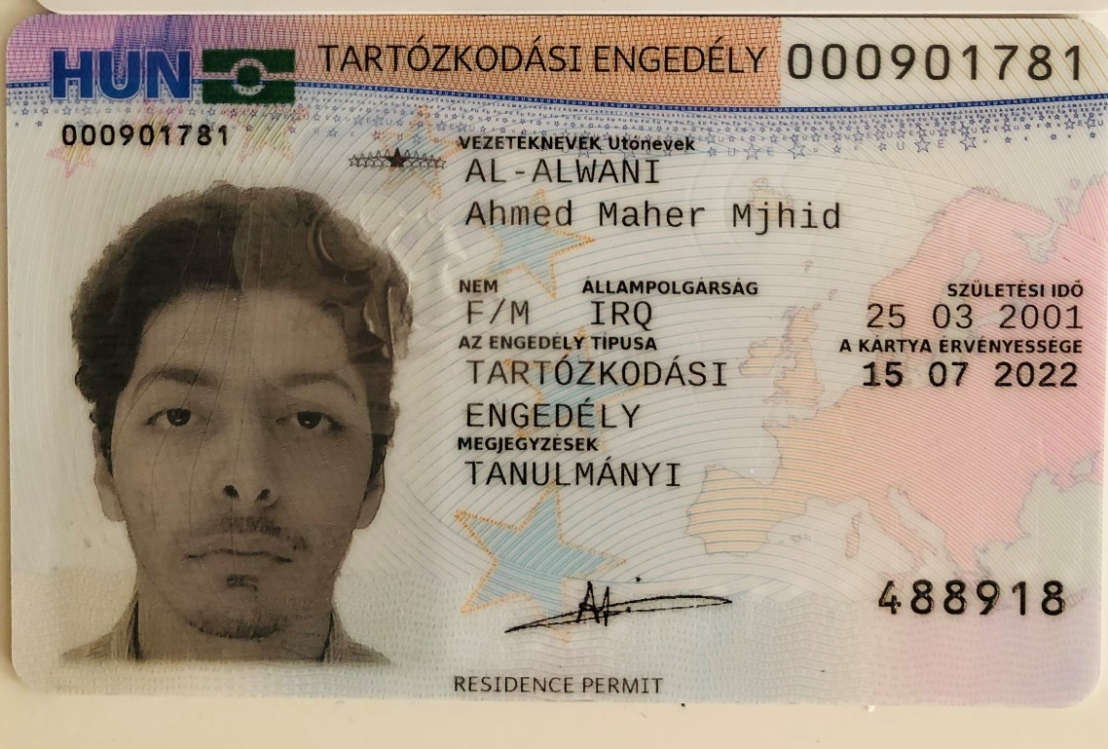
Keeping your stay legal The Residence Permit
Ch 1 legal stay

Slide 15
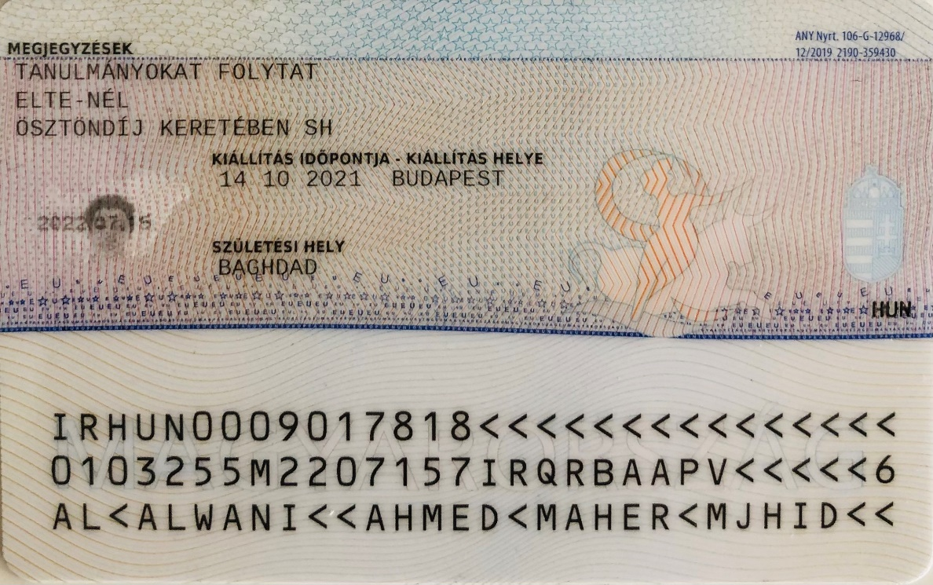
Keeping your stay legal The Residence Permit
Ch 1 legal stay

Slide 16
Chapter 2
Student ID (Student card)
Ch2 Student ID

Slide 17
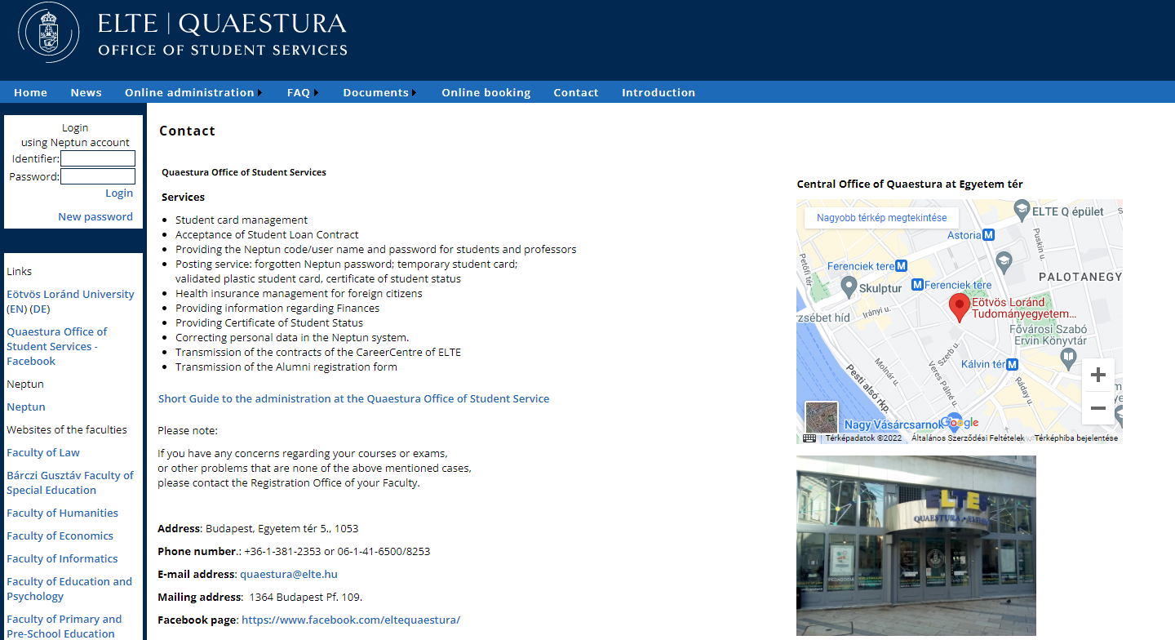
Quaestura Office https://qter.elte.hu/default.aspx - Services
Ch2 Student ID

Slide 18
Quaestura Office https://qter.elte.hu/default.aspx Services
Neptun Password help
Certificate of Student Status (active) (however the DIA office is also able to send you the certificate if you request it)
Processes Temporary Student Identification Card
Arranges Health Insurance on a fee-paying basis
Ch2 Student ID

Slide 19
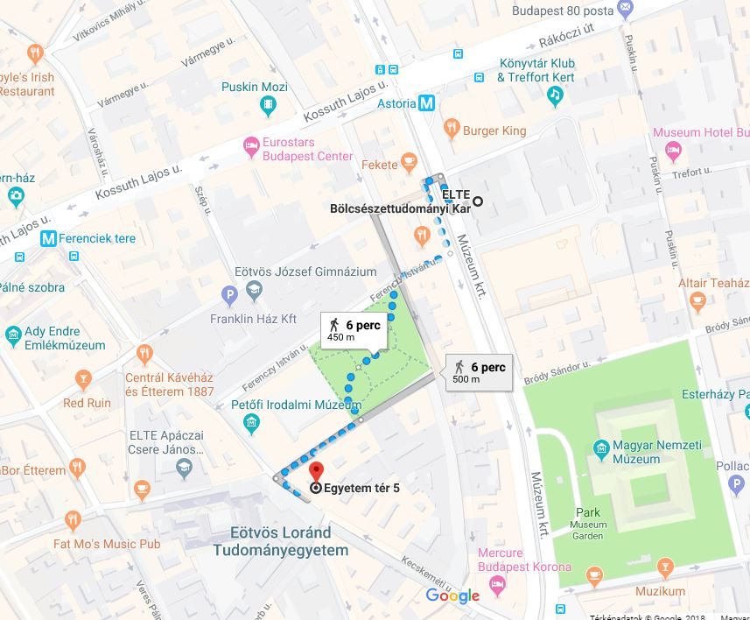
Egyetem tér 5
1053 Budapest
About a 5-10 minutes walk from the Faculty of Humanities
Ch2 Student ID

Slide 20
Quaestura Office
Opening Hours at EGYETEM TÉR 5.
(Right now. When classes start may change, please check the website that time.)
Monday: | 09:00 - 13:00
Tuesday: | 09:00 - 13:00
Wednesday: | 12:00 - 16:00
Thursday: | 09:00 - 13:00
Friday: | 08:00 - 12:00
Ch2 Student ID

Slide 21
Student Identification Students staying shorter than 12 months
Temporary Student ID paper
(A/4 format paper sheet document)
Issued by Quaestura Office described below:
https://qter.elte.hu/Statikus.aspx/GyIK-Diakigazolvany
(you most login into the Quaestura office system with your Neptun code and password)
IMPORTANT: the ID (paper A/4) is valid only for 60 days from the day it has been issued, the document can be requested from Questura according to the information provided by the
office and that can be found on the link above mentioned. After 60 days the document expires and has to be requested once again from the Quaestura Office.
Ch2 Student ID

Slide 22
Student Identification Discounted transportation in Hungary
Temporary Student ID paper is valid to be used for discounted transportation in Budapest and any other means of transportation in Hungary (bus, train,etc).
Always check for student discounts at other places (e.g. museums, cultural events, sport facilities)
Ch2 Student ID

Slide 23
Student Identification Discounted transportation in Budapest
ALWAYS carry your student ID with you
Monthly discounted pass: 3.450 HUF
Your student ID card number is necessary for the pass, you should write this number on the pass if this has not been done at the cashier
Budapest pass can be bought from ticket machines or online through „Budapest Go” app.
One way ticket: 350 HUF
Ch2 Student ID

Slide 24
Student Identification Discounted transportation in Budapest
You must have a validated ticket or a valid pass before boarding the vehicles.
BKK officials are authorized to check the validity of your ticket or pass any time during or after your trip.
Passengers without valid ticket or pass are to pay a heavy fine: 22.000,- HUF (approx. 55-60 EUR).
→ Do NOT use public transport without your Student ID paper!!!
Ch2 Student ID

Slide 25
Chapter3 Bank account
Ch 3 Bank account

Slide 26
Open a bank account in Hungary
Erasmus+ and exchange students: It is not obligatory but recommended to open a hungarian bank account, especially if you stay for a whole year.
Ch 3 Bank account

Slide 27
Open a bank account in Hungary
You can open the account at any banks.
Recommended bank:
near Astoria (campus): Károly krt. 1
OTP ATM: in building 4/A, next to the Dept. of International Affairs
Ch 3 Bank account

Slide 28
Chapter4 Campus
Ch4 Campus

Slide 29
Department of International Affairs (DIA)
Múzeum krt. 4/A
1088 Budapest
Ground floor, room 44
Administrative coordinators:
Erasmus+ exchange students: Ms. Lilla Gilián
incoming@btk.elte.hu
Other exchange students: Mr. Sándor Balaci
mobility@btk.elte.hu
Ch4 Campus

Slide 30
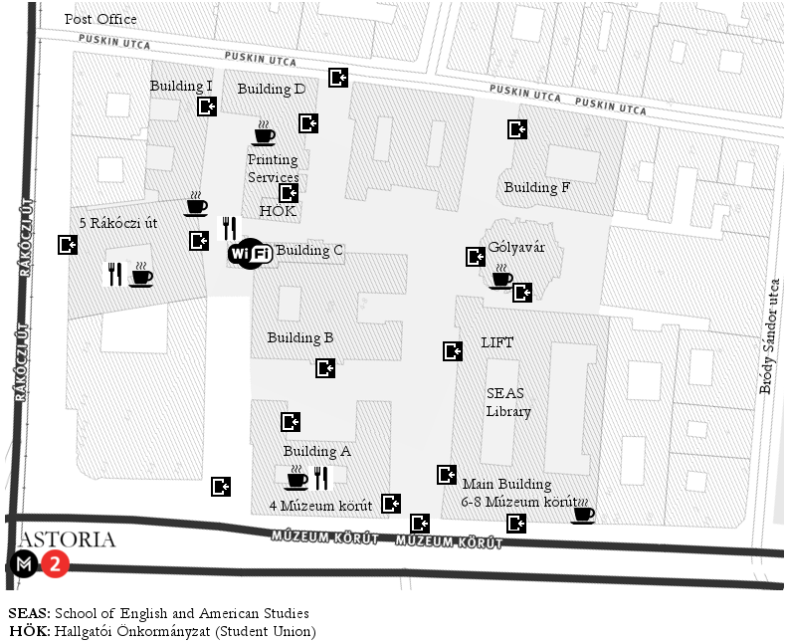
Department of International Affairs (DIA)
Ch4 Campus

Slide 31
How do I contact the DIA and my administrative coordinator?
Students have to register for office hours here: kronosz.elte.hu
Office hours:
Monday: 13.00-16.00
Tuesday: no office hours
Wednesday: 13.00-16.00
Thursday: no office hours
Friday: 09.00-12.00
Ch4 Campus

Slide 32
Student administration Registration with the DIA office
Registration at the office on the first week (27th Febr – 3rd March):
After arrival, you must visit the office for Registration
Registration is a must!
Building A, room: 44 (ground floor)
Erasmus+ exchange students: Ms. Lilla Gilián
Other exchange students: Mr. Sándor Balaci
Bring your Certificate of Arrival with yourself!!!
After 3rd March: in Office hours: ONLY with booked appointment:
Book an appointment for an office hour: kronosz.elte.hu
Ch4 Campus

Slide 33
Further useful information
Ch4 Campus

Slide 34
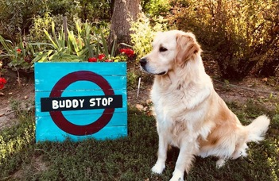
Buddy stop
Near Gólyavár building
The rule is simple: whether you just have a question or feel entirely lost, just stand under the sign. If you see someone standing there, approach them and offer a helping hand.
Ch4 Campus

Slide 35
FREE Trainings
BEING AN INTERNATIONAL STUDENT (ONLINE): TRANSITIONS, COMMUNICATION, WELL-BEING
Project aims
help you understand and cope with the process of cultural transitioning
make your cultural and educational experiences sources of learning, insight and personal growth
ensure that your psychological and social well-being is guaranteed throughout this time
create a small international community that also functions as a support group
https://www.btk.elte.hu/being_an_international_student_online
Ch4 Campus

Slide 36
Pastoral Service
Foreign students at ELTE have access to the pastoral services of PPCU
(Pázmány Péter Catholic University)
Individual and small group exercises
holy masses in English
keeping faith groups (online)
spirituality days, spiritual practice weekends during during major Catholic holidays
preparation for sacraments (baptism, confirmation)
leisure and cultural programs: excursion, film clubs
lectures, roundtable discussions on Christianity, spirituality
More information here
Ch4 Campus

Slide 37
Chapter 5 Academic Regulation
Ch5 Academic Regulation

Slide 38
Academic Regulation Plan things ahead…
Academic calendar: https://www.elte.hu/en/academic-calendar
Ch5 Academic Regulation

Slide 39
Academic Regulation: Absence Policy
if you miss more than 30% of your classes (= 3 times 90 minute slots in your timetable), you will not get a grade and have no credits
Ch5 Academic Regulation

Slide 40
Chapter6 Technical issues, and other practical matters
Ch6 Technical issues, practical matters

Slide 41
Use Wi-fi at the campus
You can use wi-fi at the university with your ELTE Caesar account.
You have already received info on ELTE accounts in the info letters.
More info:
https://www.elte.hu/en/it-support
Ch6 Technical issues, practical matters

Slide 42
Copy shop
At the campus:
In building R, ground floor
Ch6 Technical issues, practical matters

Slide 43
Book shop
Book shop at the campus: A building, basement room number: -176
Ch6 Technical issues, practical matters

Slide 44
Libraries
English and German language library: main building
seaslib@btk.elte.hu
germbibl@btk.elte.hu
Ch6 Technical issues, practical matters

Slide 45
Libraries
Every department has its own library. Ask your academic coordinators or course lecturers for information, other suggestions.
Ch6 Technical issues, practical matters

Slide 46
Libraries
University library & catalogue: https://konyvtar.elte.hu/en
Online database available for ELTE students: https://eltekonyvtarak.elte.hu/en/egyetemi-konyvtari-szolgalat/adatbazisok/adatbazislista?redirect
University library & catalogue: https://konyvtar.elte.hu/en
Online database available for ELTE students: https://eltekonyvtarak.elte.hu/en/egyetemi-konyvtari-szolgalat/adatbazisok/adatbazislista?redirect
Ch6 Technical issues, practical matters

Slide 47
Eating facilities near the campus
Műhely Egyetem Café (at the campus): soups, salads, sandwiches, coffee, tea, desserts
Ch6 Technical issues, practical matters

Slide 48
Eating facilities near the campus
Vega City: Múzeum krt. 23. (vegan food, menus, burgers)
Subway: Astoria (sandwiches)
McDonald’s: Astoria
Burger King: Astoria
Bamba Marha Burger: Astoria
Manu+: Múzeum krt 7. (Neapolitan pizza)
Black Cab burger: Rákóczi út. 19. (hand-made burgers)
Zoska: Ferenczy István utca 28. (breakfast and café)
Csendes: Ferenczy István utca 5. (restaurant)
Belvárosi Disznótoros: Károlyi utca 17.(Hungarian food)
Padthai Wok Bar: Egyetem tér
Ch6 Technical issues, practical matters

Slide 49
Eating facilities near the campus (shops)
Tesco Express: Astoria (supermarket)
Aldi: Kossuth Lajos utca 13. (supermarket)
Lipóti bakery: Rákóczi út 4-6.
City Spar: Károly körút 22-24. (supermarket)
Ch6 Technical issues, practical matters

Slide 50
Attention:
In many cases official emails sent from the …@btk.elte.hu are automatically directed into a spam folder of your email account.
Always check the spam folder!
Ch6 Technical issues, practical matters

Slide 51
Chapter 7 Documents during the semester
Ch7 Docs during the semester

Slide 52
Guest Student Course Registration Form
After arrival
Courses you could not register yourself
Teachers’ permissions
Form → Submit at office personally until:
31st March
(the sooner-the better!)
Ch7 Docs during the semester

Slide 53
In parallel with registering the courses in the Neptun system, please also register, list them on the document which can be downloaded from the website of the Faculty.
Please download the document: GUEST STUDENT FORM here.
(click on Documents)
For the courses listed on the form you couldn’t register yourself (any reason like prerequisite requirement or the course was full or the deadline was over…etc) you must request the course instructor’s/ lecturer’s approval (signature!) to take part in the course.
The approval should be requested by you from the teacher. Please ask the teacher to sign the Guest Form. Once you have gathered the signatures on the Guest Form, please bring the Form to your administrative coordinator to building A, office 44.
The Guest Student Course Registration Form has to be signed by your academic coordinator at the end, before you submit to the DIA Office
Deadline: 31st March!
Maybe by some of the courses offered by the School of English and American Studies (SEAS) you need to ask the signature from the teachers.
Ch7 Docs during the semester

Slide 54
Guest Student Course Registration Form
Let’s re-check:
Ch7 Docs during the semester
Notes:
For the courses listed on the form you couldn’t register yourself (any reason like prerequisite requirement or the course was full or the deadline was over…etc) you must request the course instructor’s/ lecturer’s approval (signature!) to take part in the course.
The approval should be requested by you from the teacher. Please ask the teacher to sign the Guest Form. Once you have gathered the signatures on the Guest Form, please bring the Form to your administrative coordinator to building A, office 44.
The Guest Student Course Registration Form has to be signed by your academic coordinator at the end, before you submit to the DIA Office
Deadline: 3rd October!
Probably for most of the courses offered by the School of English and American Studies (SEAS) you need to ask the signature from the teachers.

Slide 55
Learning Agreement (for Erasmus+)
Always the academic coordinators are signing the document (not Lilla or Sándor!)
Before the mobility part: if it is not signed yet, have it signed
During the mobility part: if your courses change compared with the Before part, fill it in, and have it signed
After the mobility: only necessary if your home university requests it
List of the academic coordinators:
https://www.btk.elte.hu/erasmus_academic_coordinators
Ch7 Docs during the semester

Slide 56
Confirmation of Arrival (for Erasmus+)
Please use the form given by your home university or download it from your home university website.
The signature of this document can be requested only in person from your administrative coordinator at the DIA office after your arrival.
For the signature on the Certificate of Arrival please contact in person the DIA office during the office hours even without booking an appointment on the first academic week.
AFTER 3rd March, in order to visit the DIA office in person:
Please book an appointment:
kronosz.elte.hu
Ch7 Docs during the semester

Slide 57
Documents before leaving
1. Transcript of Records
2. Certificate of Attendance/Stay/Departure
Ch7 Docs during the semester

Slide 58
Transcript of Records
The Transcript of Records will be issued by the Department of International Affairs (DIA) and it will be generated by the Neptun system.
Make sure that all your grades are recorded in the Neptun system before your departure so that we can issue your official Transcript of Records. When all the marks are vidible in Neptun, write us an email and the signed document will be electronically sent to your email address.
Ch7 Docs during the semester

Slide 59
Confirmation of Stay / Certificate of Attendance
Please use the form given by your home university or download it from your home university website.
If it is not available, let us know personally and we will use the ELTE form, more information will be provided before the examination period.
PERSONALLY, never earlier than 10 days before your departure!
Ch7 Docs during the semester

Slide 60
ELTE Caesar account (IIG ID) & email address
Benefits:
ELTE WIFI
access to MS Office 365
the official letters are sent to the ELTE email
No problem with Hotmail, Yahoo mails
via Outlook, your emails are available on every device
access to Microsoft Teams
Step-by-step guide: https://www.elte.hu/en/it-support
IIG ID can be required here.
When you get your ELTE email address, do not forget to register it in the Neptun system:
Log in to Neptun
Go to the My data
Click on Contact information
Click on New Email address
Type your email address and click on the save button.
Enjoy your brand new, personalized ELTE email address!
Compulsory!
Ch7 Docs during the semester

Slide 61
Chapter 8
Courses
Ch 6 Courses

Slide 62
Departmental coordinators
With study issues, always contact your academic coordinator!
(teacher, academic staff member of the department/institute, who confirmed your acceptance and LA)
Available courses and list of the coordinators: https://btk.elte.hu/en/content/course-catalogue-for-incoming-erasmus-students.t.3543?m=261
If you still need assistance ask for help from your administrative coordinator (Lilla or Sándor ☺)
Ch 8 Courses

Slide 63
How to sign up for the courses?
You can sign up for your courses in Neptun system.
Do not worry if you cannot register for one or more courses because of a course prerequisite obligation or if you miss the registration deadline. Lilla and Sándor will register the course in your Neptun but you must present the teacher’s signature and correct course code on the Guest Form.
Neptun tutorial film: please copy, paste the link into your web browser to access the site:
https://www.btk.elte.hu/media/f6/76/c6c39ebe6beb04f10ce392110e83efb47648c17aecef594d0dacddee3aed/Neptun%20tutorial.mp4
(More details about the course registration soon at the end of the presentation.)
Ch 8 Courses

Slide 64
Hungarian Language Courses for Erasmus+ and other exchange students
Details:
General Hungarian language course I. / II.
https://www.btk.elte.hu/hungarian-language-courses
Contact: hungarian_course@elte.hu
Ch 8 Courses

Slide 65
Sport courses
You can sign up for sport courses in Neptun system.
OR
You can choose other courses offered by BEAC (Budapest University Athletic Club).
You have to pay for all of the courses via Neptun/Q-space (official fee: 6000 HUF)
Please ask the trainers if there is any other fee to be paid, apart from the official fee indicated by Neptun for the respective course!
More info:
https://www.beac.hu/in-english/
Ch 8 Courses

Slide 66
Chapter 9
Quick Neptun training - Course registration
Ch 9 Neptun

Slide 67
How to use Neptun?
First of all, you need to be able to log in.
You got a Neptun code: combination of 6 digits/letters
To be able to log in, generate your own password on the website of our Quaestura Information Office (https://qter.elte.hu/UjJelszo.aspx).
Please, read the instructions in the Neptun code email!
It is essential to generate a new password and enter the system before you register for the university.
What will you need for generating a new password?
Your mother’s birth name (in Hungarian format: Family name first, then First name second, only the first letters are capital letters. ie: Anna Smith will be: Smith Anna)
Zip code of permanent address
Passport number (or ID number, if you don’t have passport) – what you gave in the registration form!
In case you have any problems, remarks, please, contact your international administrative coordinator
Ch 9 Neptun

Slide 68
How to use Neptun?
Ch 9 Neptun

Slide 69
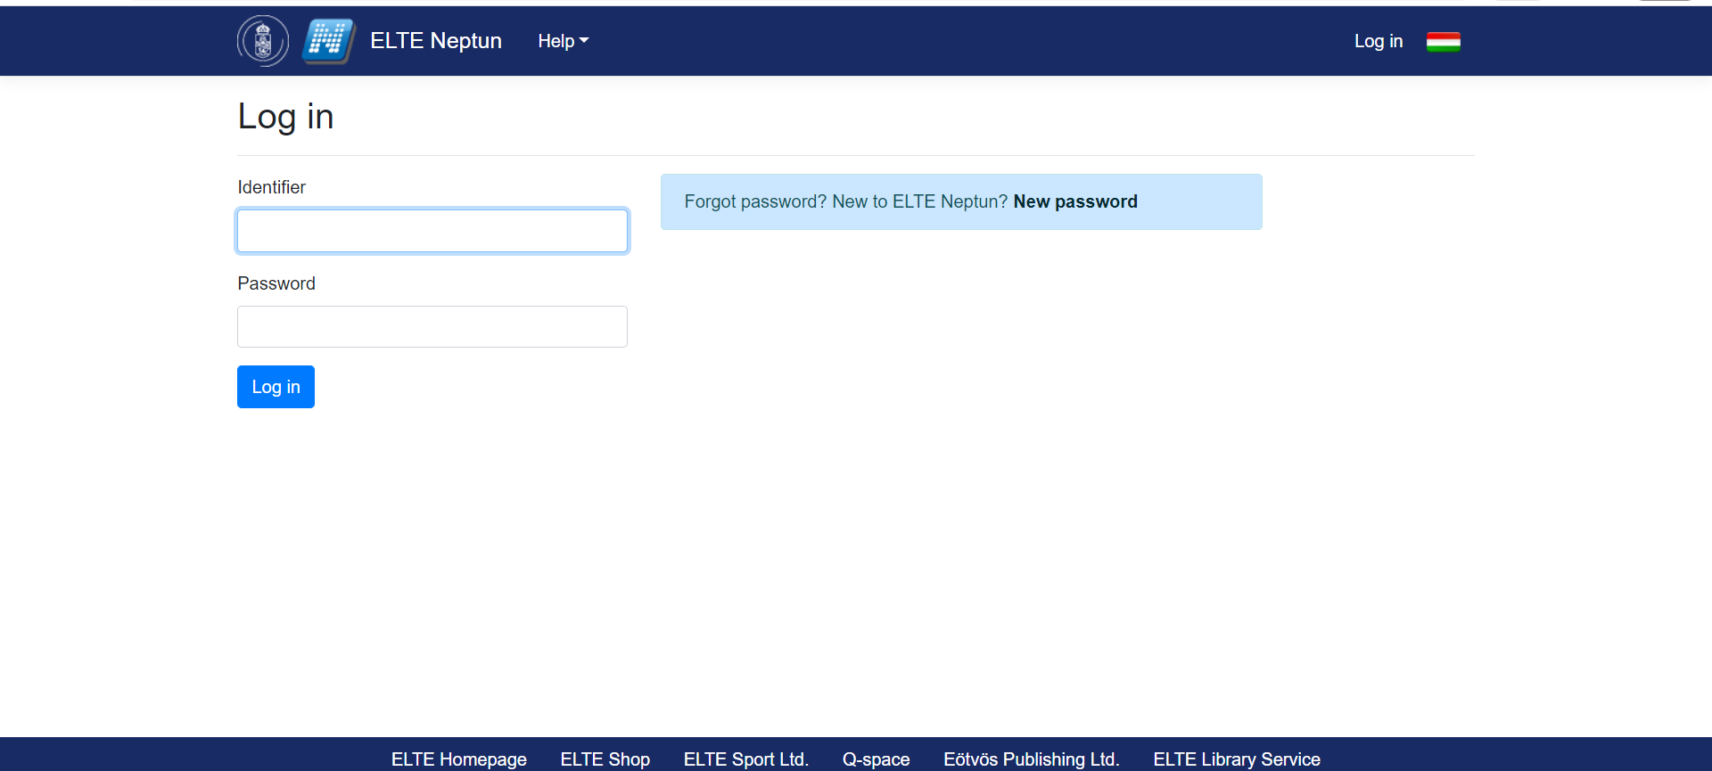
How to use Neptun?
Ch 9 Neptun

Slide 70
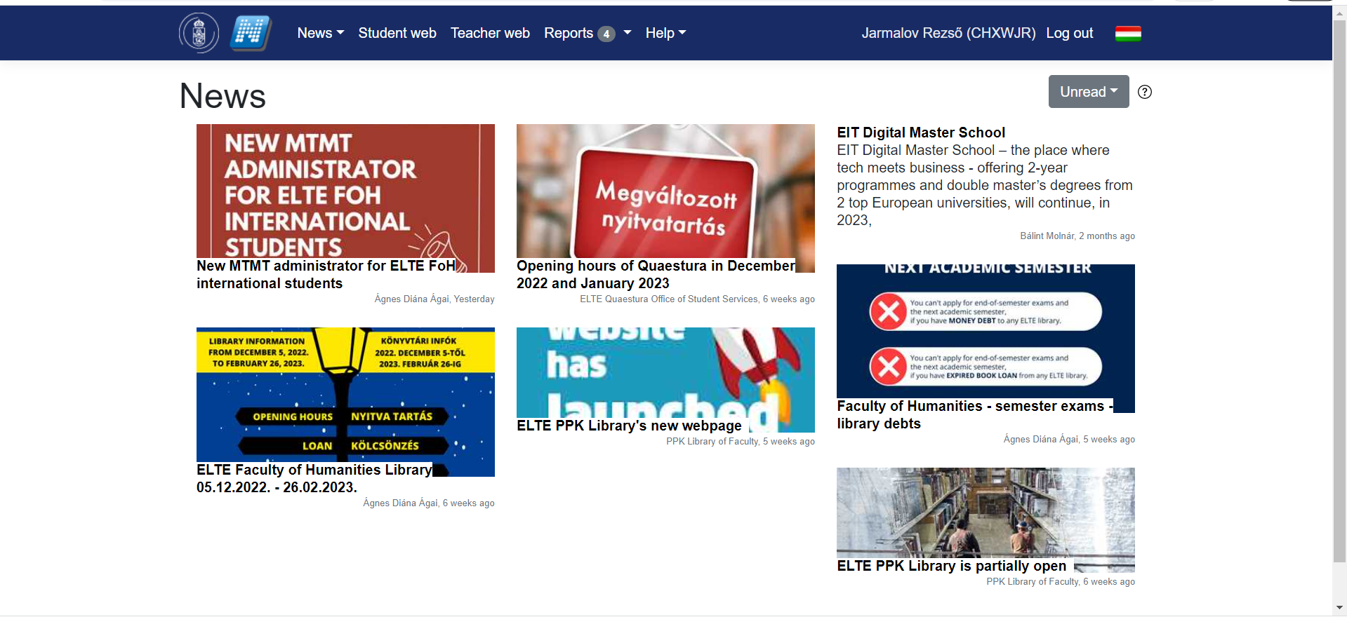
How to use Neptun?
Ch 9 Neptun

Slide 71
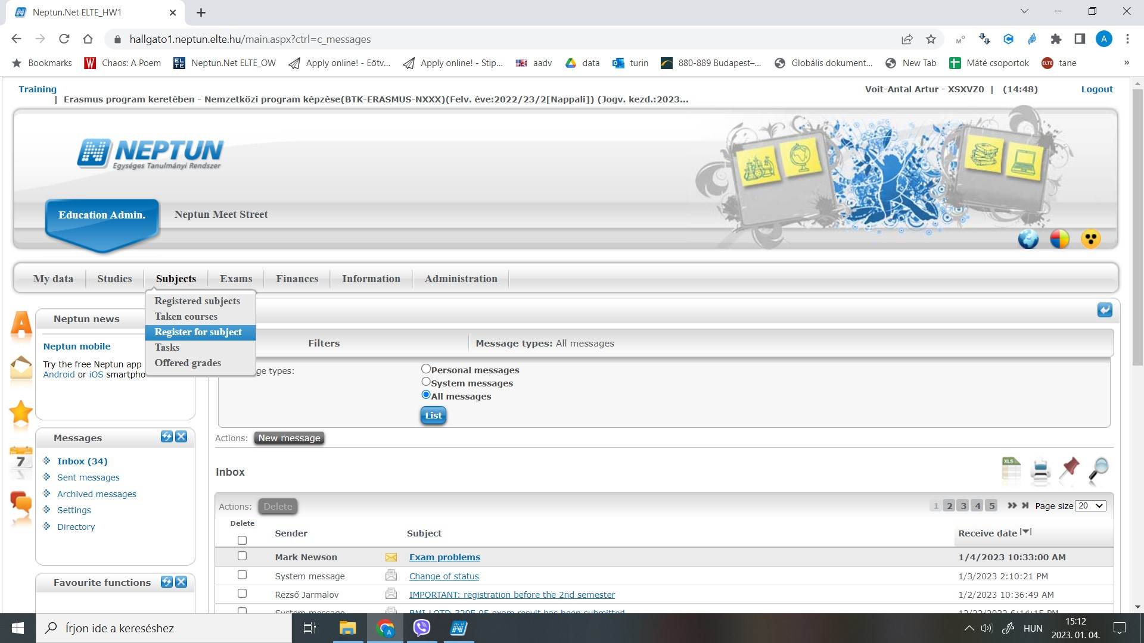
Neptun
Ch 9 Neptun

Slide 72
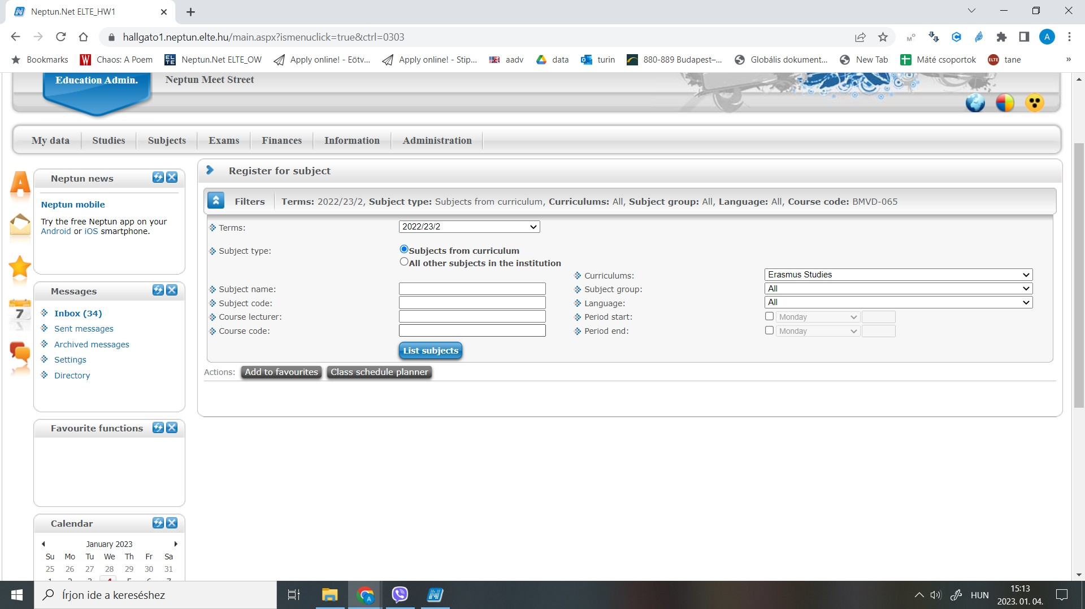
Neptun
Ch 9 Neptun

Slide 73
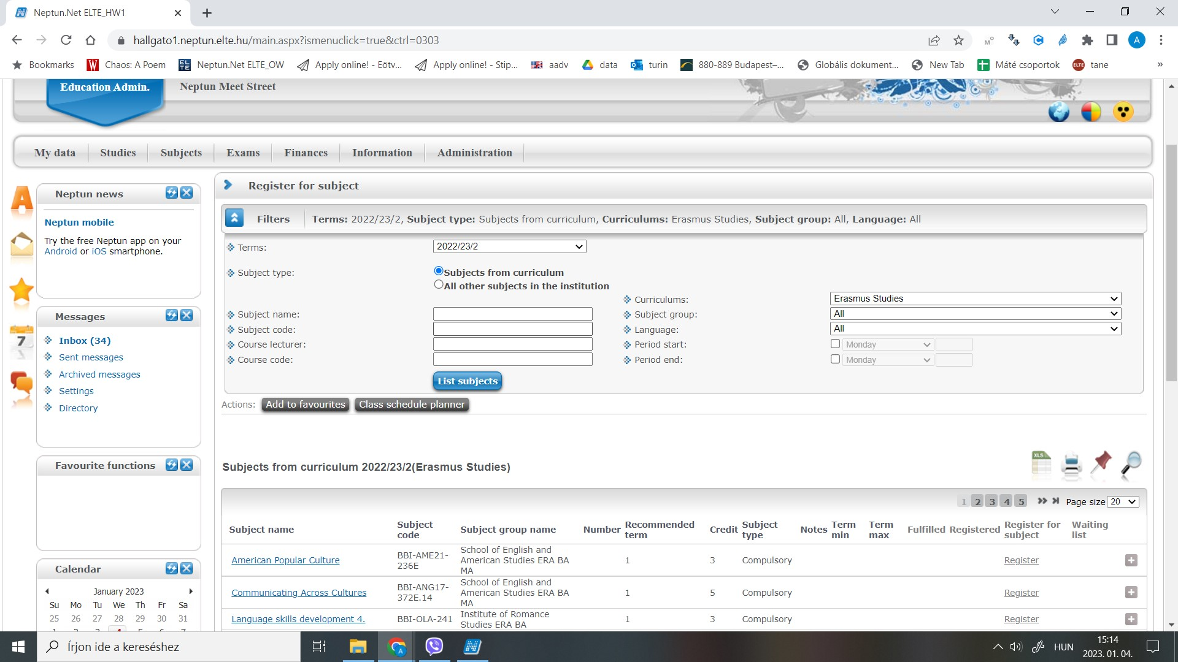
Neptun
Ch 9 Neptun

Slide 74
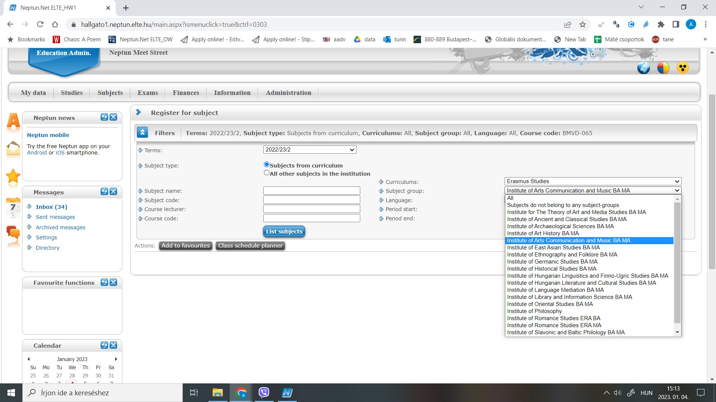
Neptun
Ch 9 Neptun

Slide 75
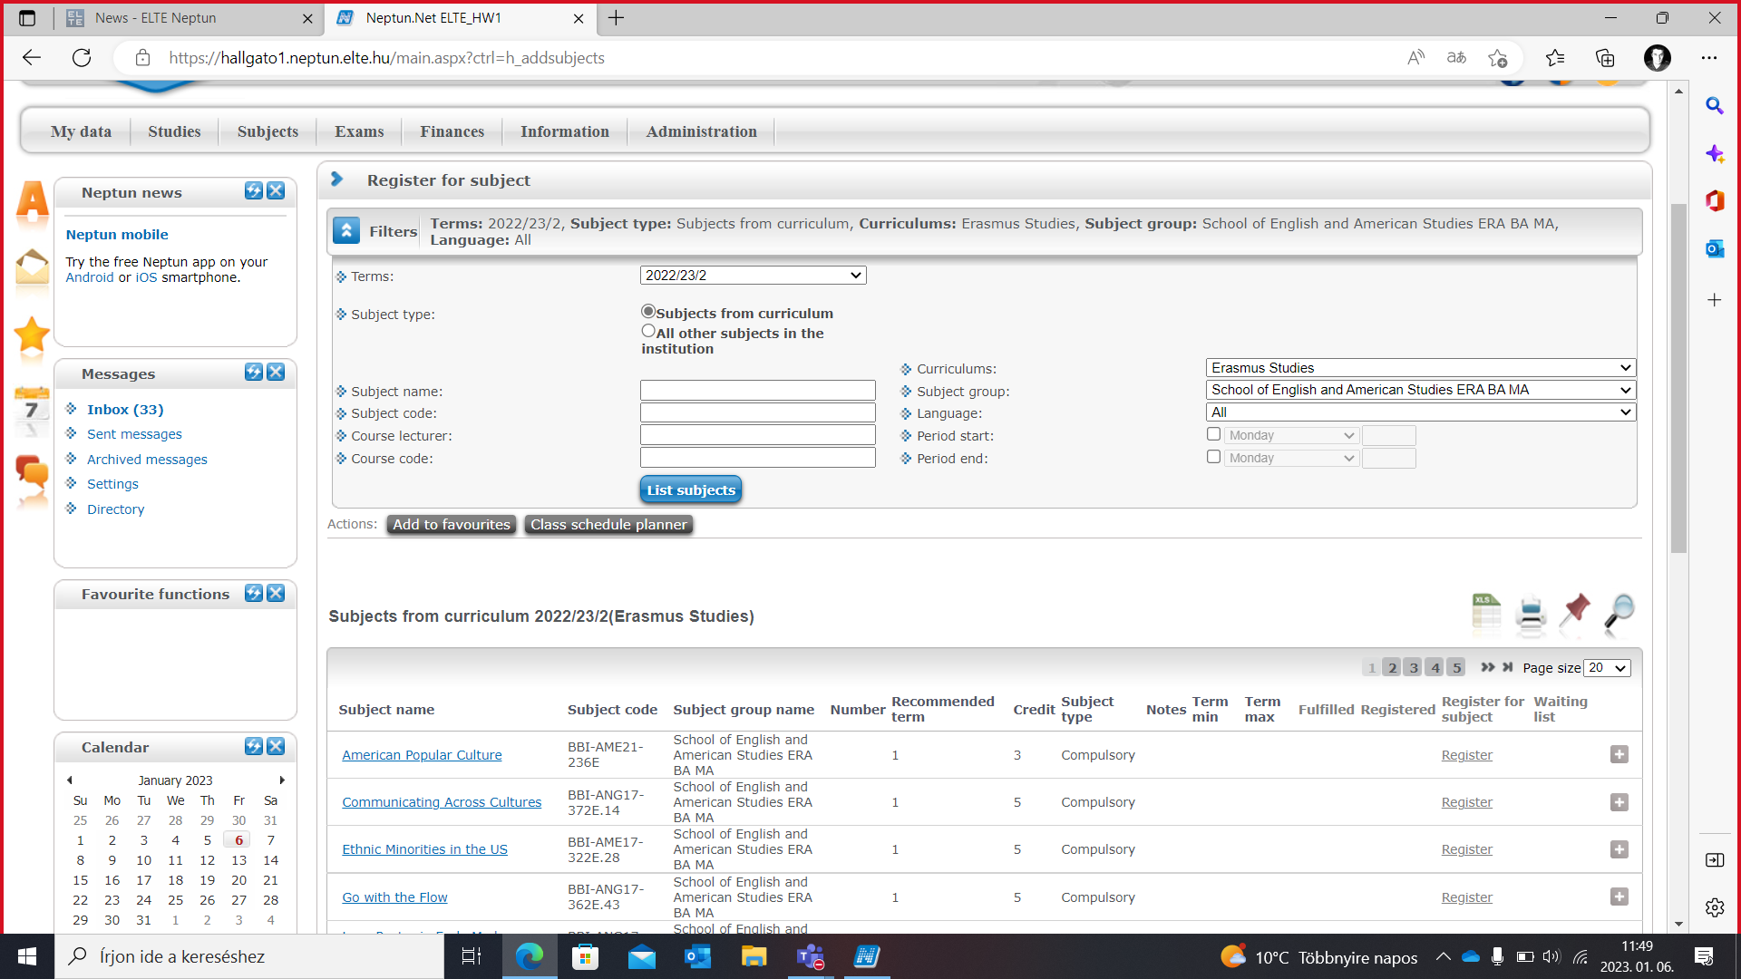
Neptun
Ch 9 Neptun

Slide 76
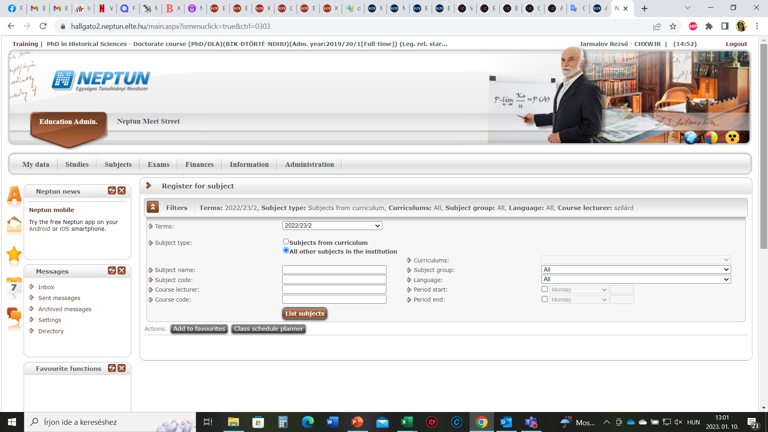
Neptun
Ch 9 Neptun

Slide 77
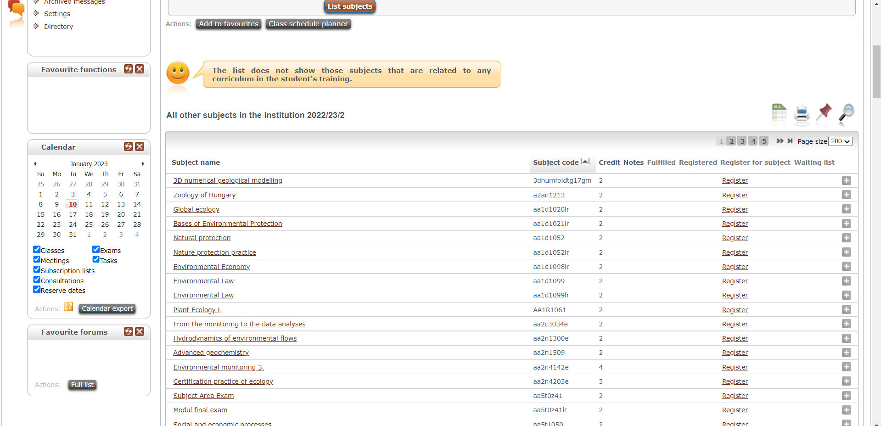
Neptun
Ch 9 Neptun

Slide 78
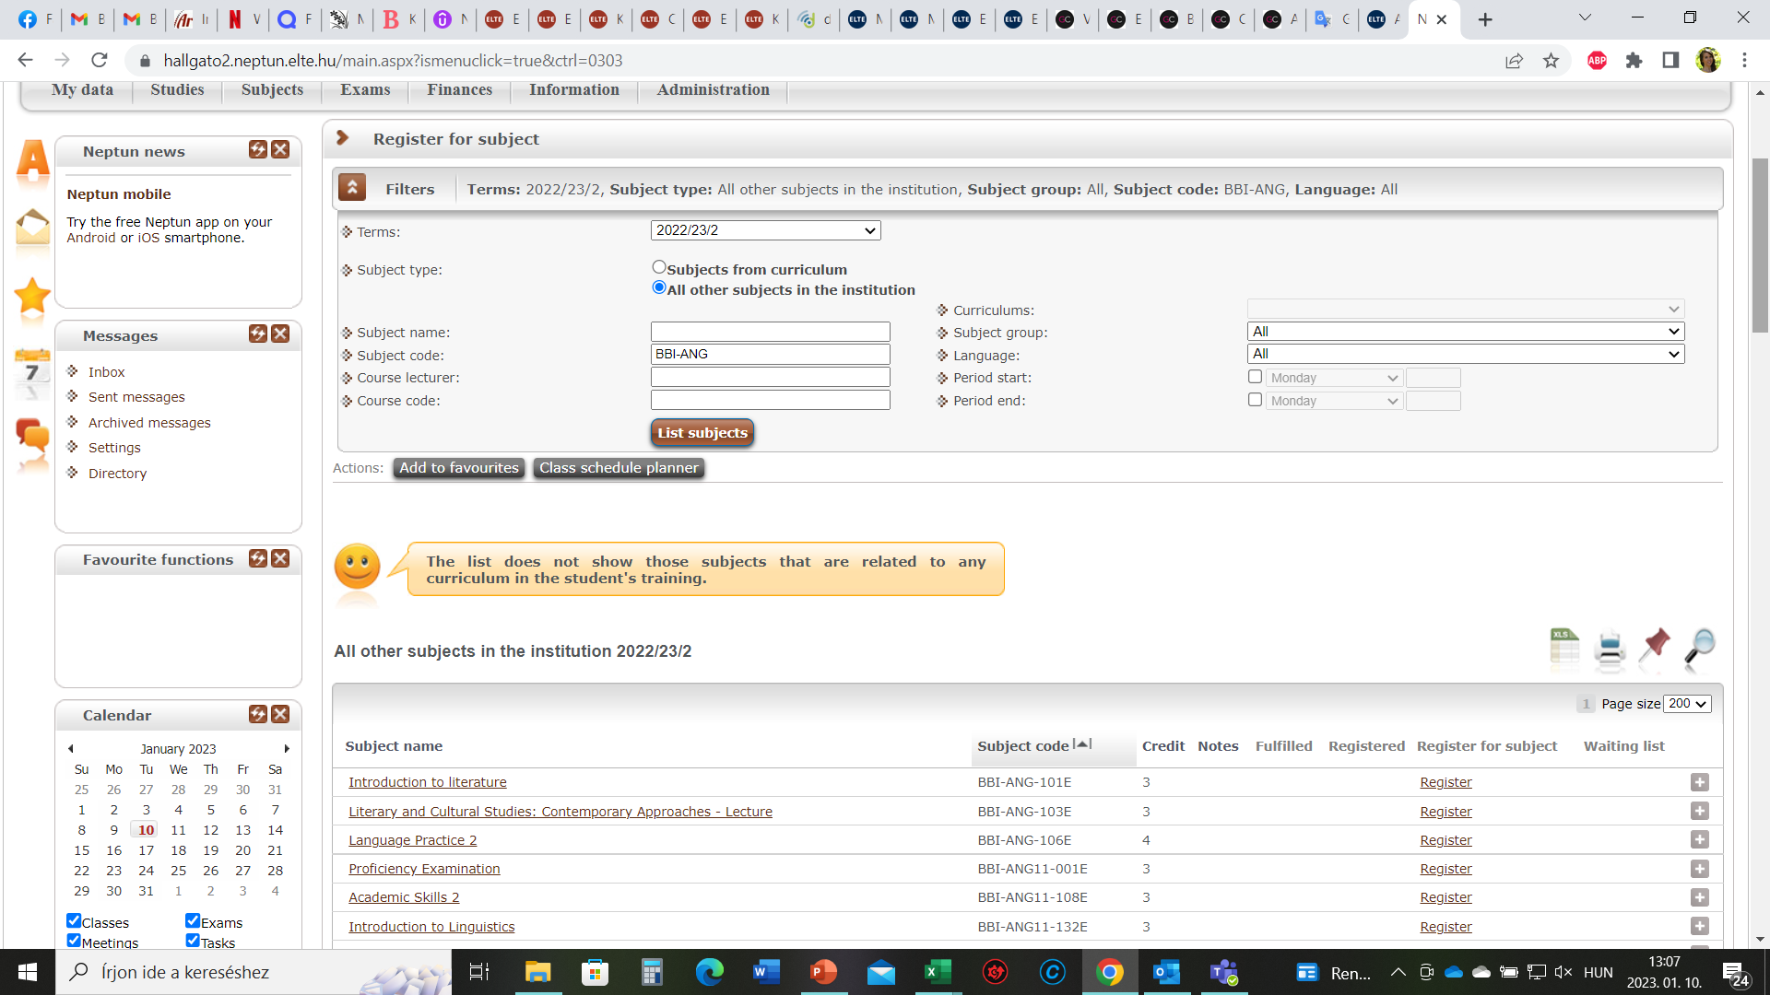
Neptun
Ch 9 Neptun

Slide 79
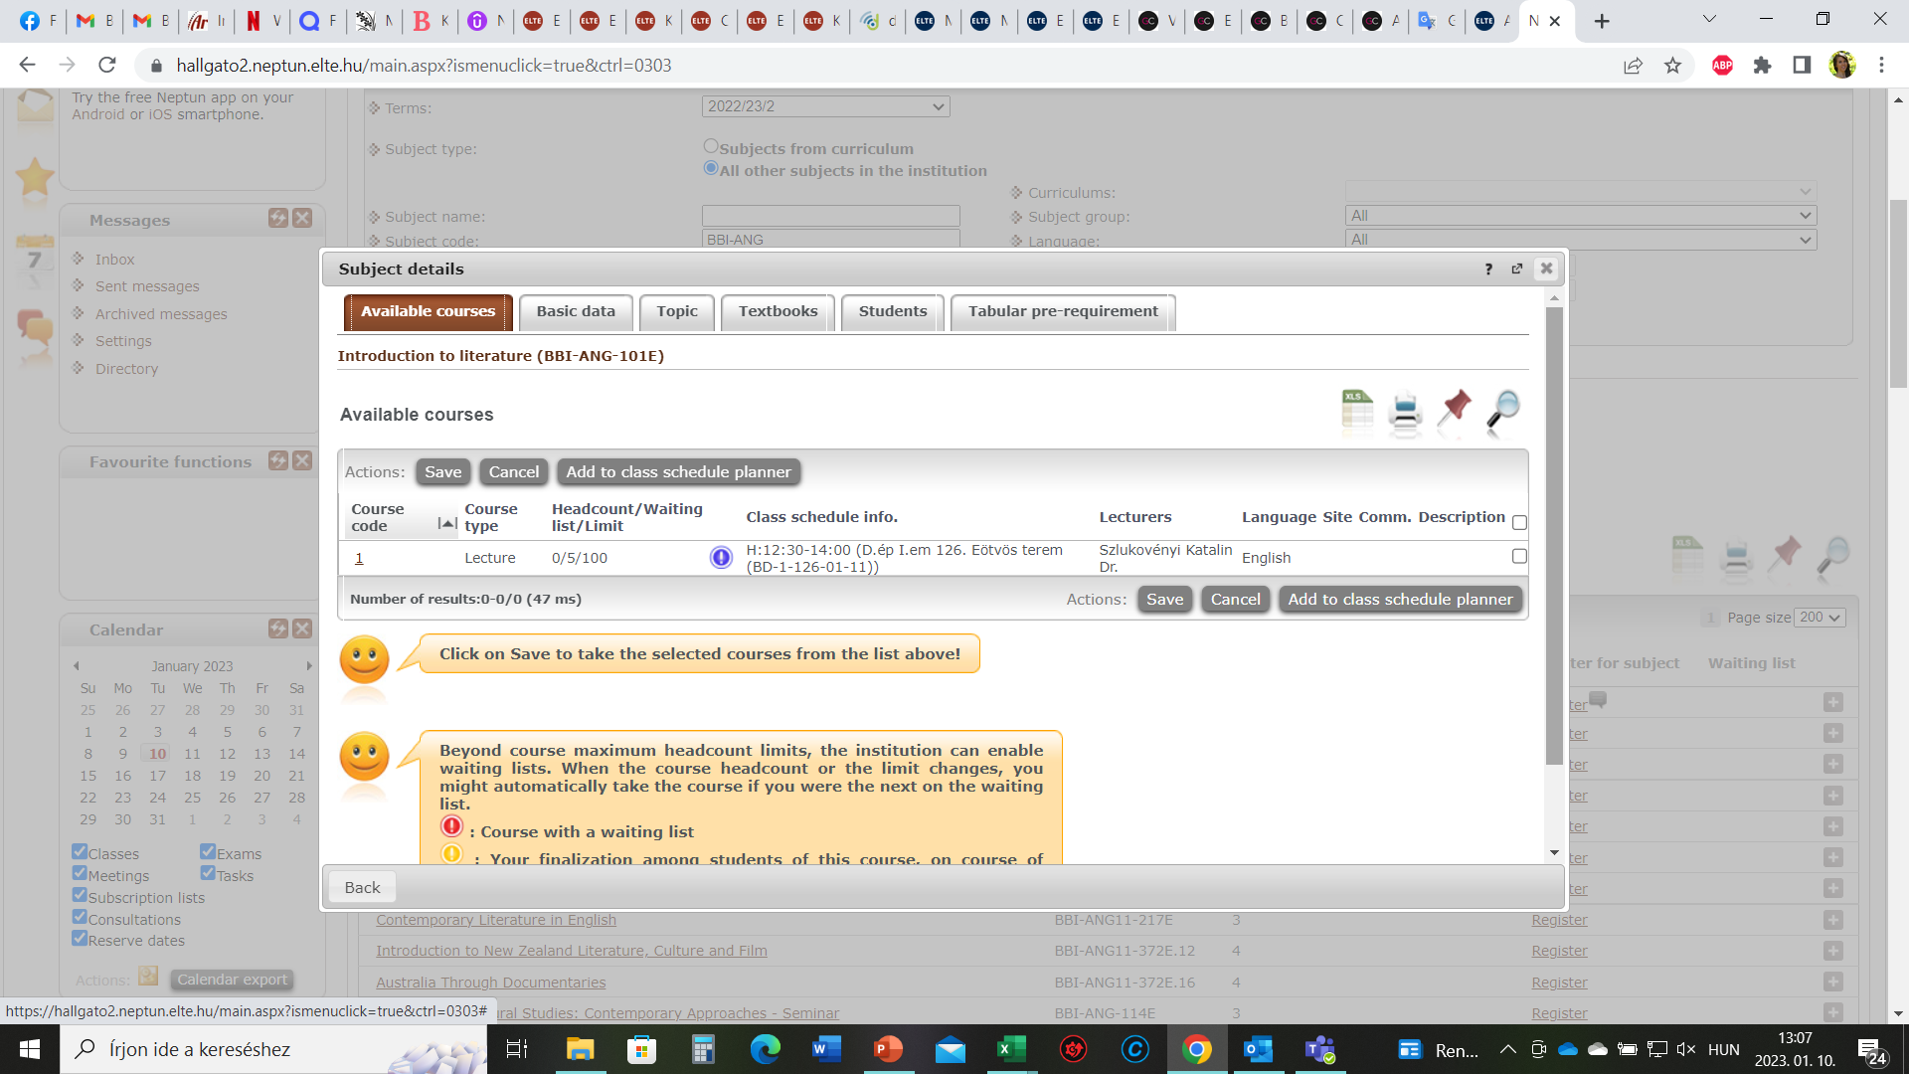
Neptun
Ch 9 Neptun

Slide 80
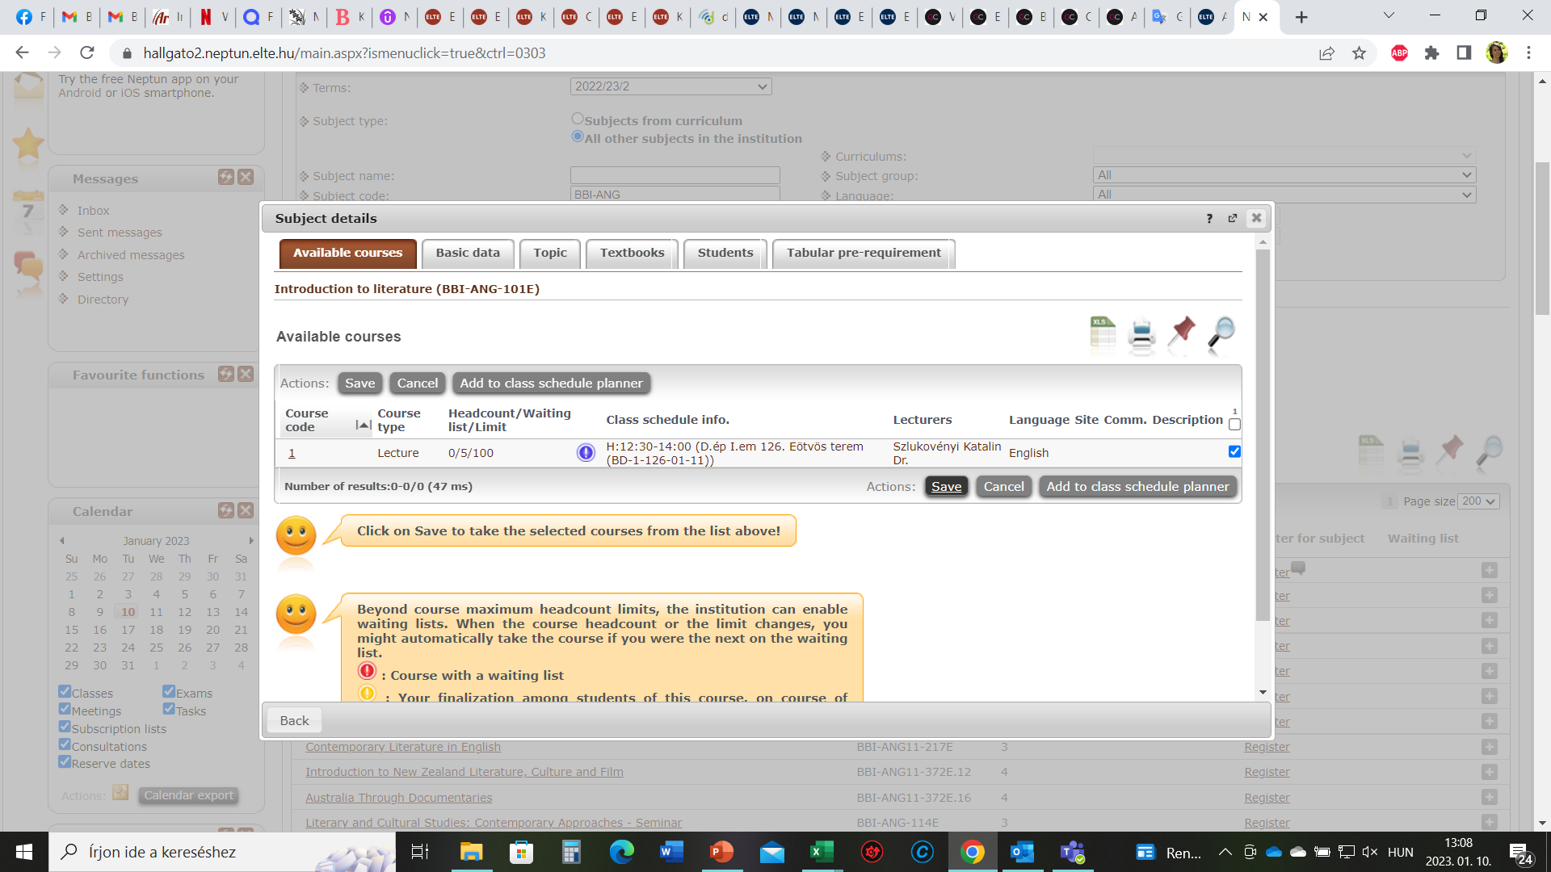
Neptun
Ch 9 Neptun

Slide 81
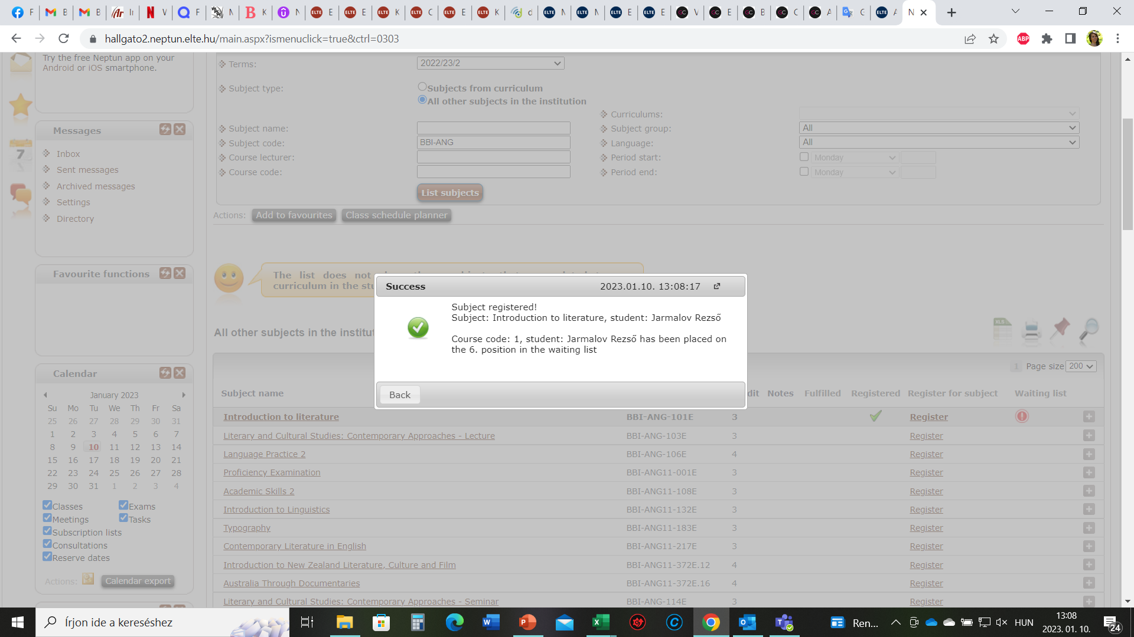
Neptun
Ch 9 Neptun

Slide 82
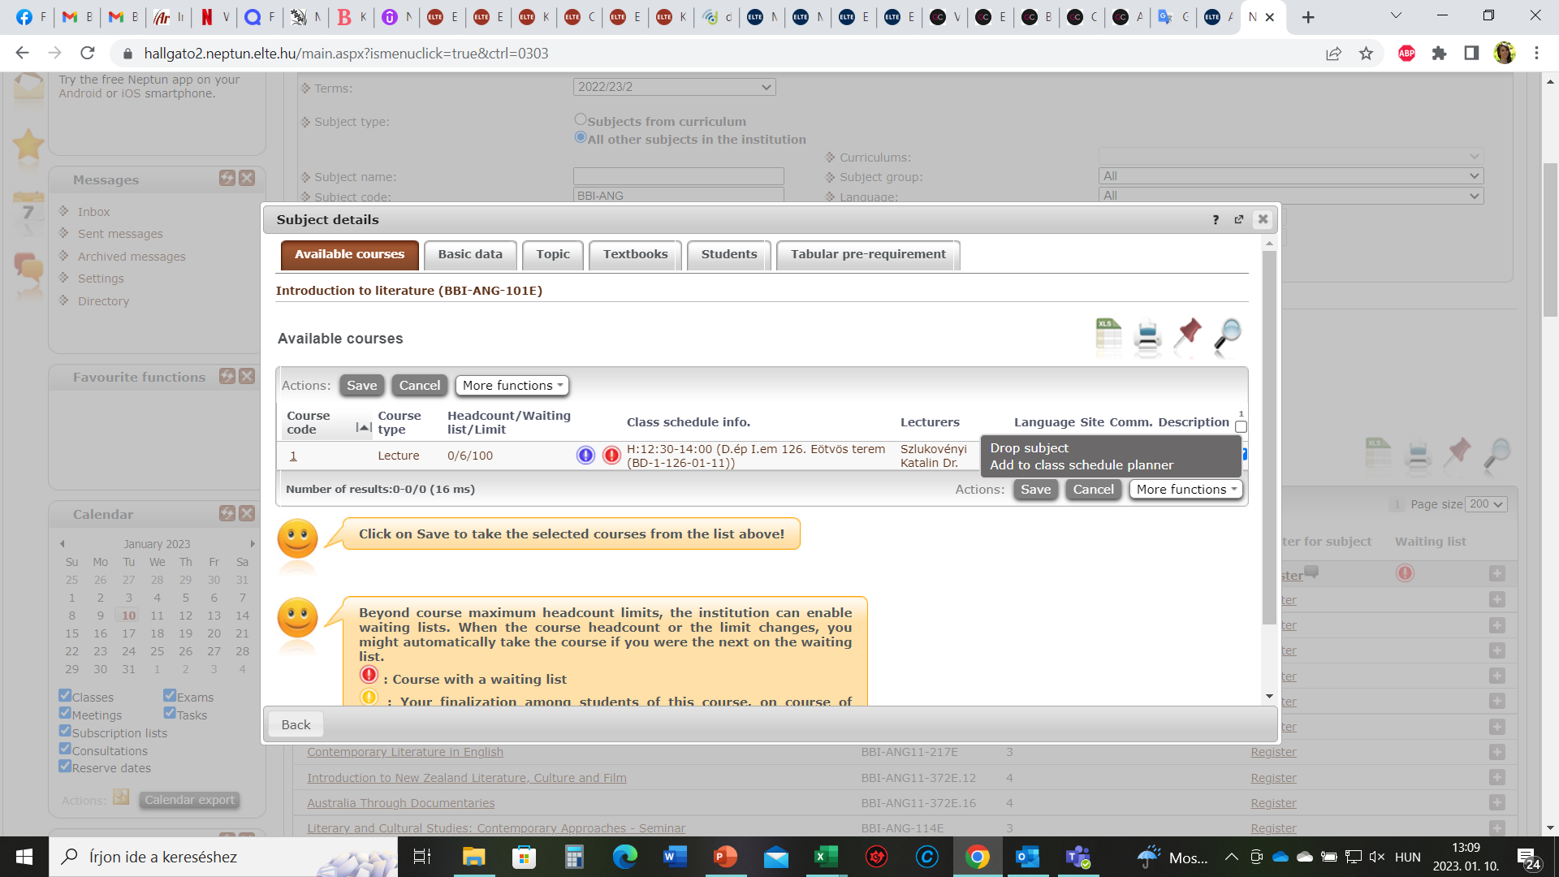
Neptun
Ch 9 Neptun

Slide 83
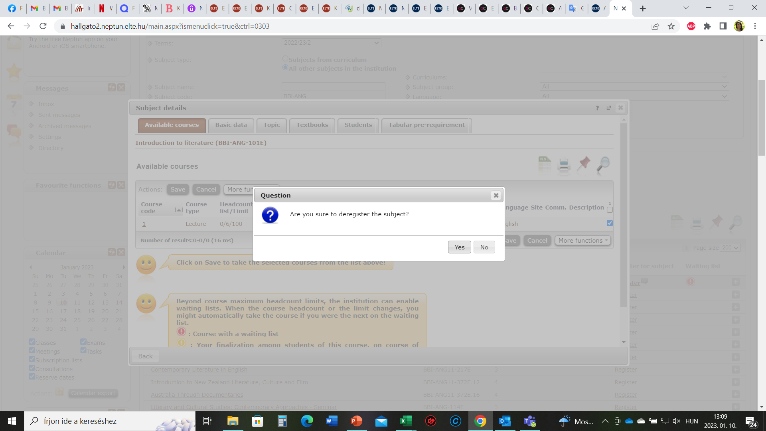
Neptun
Ch 9 Neptun

Slide 84
Neptun
Ch 9 Neptun

Slide 85
Course registration periods
Pre-course registration period: until 16th February 5 pm
16th February after 5 pm there is a „ranking period” – according to the point system, Neptun lets the students with the most points to stay on the course registered.
First come first serve course registration period: from 17th February, 8 am – 3rd March 4 pm. (The fastest the best)
https://www.btk.elte.hu/academic-calendar
It may happen that there is a pre-requisite at a course – Guest Form after arrival
Ch 9 Neptun

Slide 86
Neptun / course registration
First come first serve course registration period: from 17th February, 8 am
After the ranking period, if you have less points than others, you will be dropped from the course by Neptun.
So, you need to be quick to register yourself again for the free places offered for the rest of the students (like in a competition)
If it is successful, you are enrolled to the course
If not, after your arrival you need to ask the teacher’s permission on the Guest form, and by submitting the Guest Form to me, I will register you onto the courses for which you got the permission.
Questions: please contact your administrative coordinator (academic questions: academic coordinator)
Ch 9 Neptun

